Slide 1
Pearls and Pitfalls: Advance Directives and Surrogate Decision Making Andi Chatburn, DO, MA, HEC-C Regional Director of Ethics, EWA MT Rebecca Mallo, MD, FABIM Division Lead, Internal Medicine

Slide 2
Please Silence Your Devices
Notes:
You are each muted at this moment. There will be a time of question and answer at the end when the moderator will unmute your device. Please make sure that your accessory devices such as phones and pagers are muted so that we don’t experience those sounds and feedback during the question and answer.

Slide 3
Welcome
Notes:
Throughout 2021 and beyond, the Ethics Leadership Council commits to honor and center indigenous, black and brown members of community near and far, and on whose land we inhabit.
By placing all four corners of my feet solidly on the ground beneath me, and as I breath in and out, I honor the tribal lands and ancestral home of the Spokane, Couer d’Alene, Kootenai, and Salish people, who continue to thrive and bring rich wisdom to community. Please take a moment to honor the indigenous communities on whose land you currently stand, with gratitude through your body and breath- awareness in this moment of the four corners of your feet, as well as the earth below and sky above.
Mary Lyons, of the Leech Lake Band of Ojibwe says, “When we talk about land, land is part of who we are. It’s a mixture of our blood, our past, our current, and our future. We carry our ancestors in us, and they’re around us.

Slide 4
No Financial Disclosures

Slide 5
Objectives
Describe common ethical and legal dilemmas that arise in care of persons at the end of life
Introduce evidence-based model for communication with patients about goals of care
Discuss benefits, best practices and moral hazards in the application of Advance Directives, POLST forms, and surrogate decision-making WA State Informed Consent hierarchy
Review informed consent and clinical assessments of medical decision-making capacity vs. competency as applied in clinical settings

Slide 7
RCW Chapter 71.32 (mental health advance directives)

Slide 8
https://journals.sagepub.com/doi/full/10.1177/1049909121994313

Slide 9
Common Ethical Dilemmas at End of Life
Withholding and Withdrawing medical interventions
Code Status and Unilateral DNAR
Artificial Hydration & Nutrition
Turning off ICD or much less commonly, pacemaker
When to stop chemo/XRT?
Mechanical Ventilation
Unclear or disagreeing Surrogate Decision Makers
Surrogates not utilizing substituted judgement
Non-Beneficial or Futile medical interventions
Notes:
Add within substituted judgement: unique religious preferences at end of life

Slide 10
Ring Theory of Personhood
Societal
Relational
Individual
Innate
Radha Krishna, 2014.
Notes:
Singapore.

Slide 11
Views of Life: Basis of our obligations
Clinical Condition & ADLs
Personal Pursuit of Values/Living
Quality of Life

Slide 12
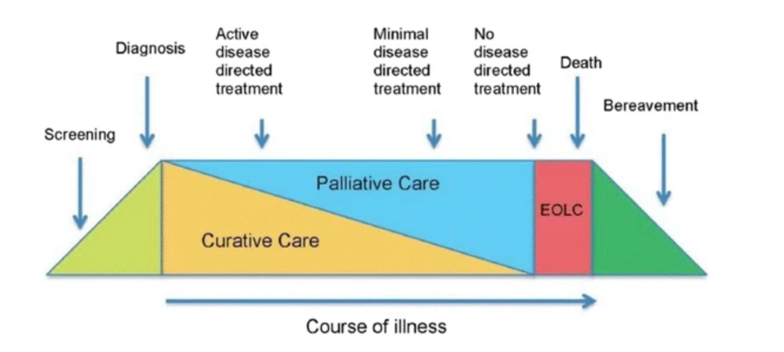
The Disease Spectrum
Fox, S., et al. 2018.

Slide 15
Cagle

Slide 16
Capacity- Medical
Capacity is both specific and dynamic.
Specific Question
Specific Time
Dynamic- can change based on time and question
Appelbaum, 2007.

Slide 17
Determining Capacity
Any provider can determine capacity.
Usually, this is the responsibility of the attending, who determines whether the patient can sufficiently:
1. Receive information in patient centered language
2. Evaluate, deliberate, and mentally manipulate information
3. Communicate a treatment preference
4. Consistency with patient values
Notes:
Understanding. Does the patient adequately understand the information about the risks,
benefits, and alternatives of what is being proposed? The patient does not have to agree with
your interpretation, but should be able to do a basic "teach back" of what you have shared
about the risks, benefits and alternatives in their own words.
Logic. Is the logic the patient uses to arrive at the decision “not-irrational”? One wants, as
much as possible to make sure the patient’s values are speaking, rather than an underlying
mental or physical illness. Note: Severe depression or hopelessness will make it difficult to
interpret capacity; consult psychiatry for assistance in complex cases.
Consistency. Is the patient able to make a decision with some consistency? This means not
changing one’s mind every time one is asked. Is the decision consistent with the patient’s
values? If there is a change in the patient values, can the patient explain the change?

Slide 18
Capacity Spectrum
Low Risk
High Risk
Less invasive
Less detailed
Less teach back
More invasive
More detailed
Complex teach back

Slide 19
Patient Refusals
Patients who have medical decision-making capacity
are allowed to be refuse recommended
Medical interventions and make
what may seem like unreasonable
or even harmful or life-threatening decisions.
Soriano, M. and Langman 2012

Slide 20
How do patients express Autonomy?
Patient Self Determination Act 1991 →
Advance Directives
Durable Power of Attorney for Health Care
Living Will
POLST
Goals of Care Conversations

Slide 23
https://www.ariadnelabs.org

Slide 25
Notes:
The most important question on the guide is the “goals” question. Why? Because time is a great crystallizer of what is important in our lives. When time may be short, it has a way of reminding us, or redefining, what really matters. Often times, things like family come back up to the top of our list, while professional goals and responsibilities tend to fade downward.

Slide 27
What if the patient doesn’t have documents?
JAMA Network. Accessed https://jamanetwork.com/collections/5584/critical-care-medicine

Slide 30
Expectations of Surrogate Decision Makers
Must be reasonably available
Must use Substituted Judgment not Best Interests
Choosing what the patient would choose
Look to Advance Directive
Look to POLST & context
Patient’s previously stated wishes

Slide 31
Models of Surrogate Decision-Making
Best Interests
Substituted Judgment
Substituted Interests
What would serve the patient’s medical good?
What decision echoes what the patient has already said?
What would represent the patient’s values?
What are the patient’s authentic values and interests in the case given their known patterns and wishes applied to their condition?
Sulmasy & Snyder. JAMA 2010.

Slide 33
Moral Hazards of POLST & Advance Directives
Inconsistencies with patient preferences
Inappropriate use
Incoherent
New or different medical need
POLST says ‘FULL TREATMENT’ but Advance Directive says ‘No life support’
Surrogate decision maker states “he would never want that”
POLST completed without discussion with patient or surrogate
Young(er) healthy patient without chronic/terminal illness with POLST
POLST states “Attempt CPR” but “No Intubation”
Ex: intubation in setting of choking on sushi vs. metastatic lung cancer

Slide 34
Risks and Moral Hazards WITHOUT Advance Directives or other Documented Preferences
Wrong surrogate
Ex-spouse, illegally married spouse or children?
Uncertainty about patient’s preferences
No advance directive, no conversation, no wishes known
Defaulting to surrogate’s preferences
Outdated documented wishes no longer reflect patient’s current preferences

Slide 37
Resources and Further Reading
Appelbaum, P. Assessment of Patient’s Competence to Consent to Treatment. NEJM. 357; 18. 2007.
www.ariadnelabs.org
Chow, G. et al., CURVES: A Mnemonic for Determining Medical Decision-Making Capacity and Providing Emergency Treatment in the Acute Setting. CHEST. 137(2). 2010.
Fox, S., et al. Better palliative care for people with a dementia: summary of interdisciplinary workshop highlighting current gaps and recommendations for future research. BMC Palliat Care 17, 9 (2018).
Radha Krishna LK. Accounting for personhood in palliative sedation: the Ring Theory of Personhood. Med Humanit. 2014;40(1):17-21. doi:10.1136/medhum-2013-010368
Sessums, L. et al., Does this Patient Have Medical Decision-Making Capacity? JAMA 206; 4. 2011.
Soriano, M. and R. Lagman. When the Patient Says No. American Journal of Hospice & Palliative Medicine. 29(5) 401-404. 2012.
Sulmasey, D. and L Snyder. Substituted Interests and Best Judgments. JAMA. 304; 17. 2010.
Soriano, M. and R. Lagman. When the Patient Says No. American Journal of Hospice & Palliative Medicine. 29(5) 401-404.
Updates to Washington Surrogate Decision Making Law June 2019 https://www.wsha.org/articles/19127
www.wsma.org/POLST
http://www.honoringchoicespnw.org/

Slide 38
Common Ethical Dilemmas at End of Life
Withholding and Withdrawing medical interventions
Code Status and Unilateral DNAR
Artificial Hydration & Nutrition
Turning off ICD or much less commonly, pacemaker
When to stop chemo/XRT?
Mechanical Ventilation
Unclear or disagreeing Surrogate Decision Makers
Surrogates not utilizing substituted judgement
Non-Beneficial or Futile medical interventions
Notes:
Add within substituted judgement: unique religious preferences at end of life

Slide 39
Panel Clinical Experiences: Advance Directives & Surrogate Decision Making Followed by Q&A

