Slide 1
U.S. Bank
Specialty Asset Management
Farm, Ranch, Mineral and Timber Management
Jon C. Norstog – VP Farm, Ranch and Timber Management
Jon.Norstog@usbank.com
Jordan Urness – VP Wealth Management Trust & Investments
Jordan.Urness@usbank.com

Slide 2
Disclosures
This information represents the opinion of U.S. Bank Wealth Management. The views are subject to change at any time based on market or other conditions and are current as of the date indicated on the materials. This is not intended to be a forecast of future events or guarantee of future results. It is not intended to provide specific advice or to be construed as an offering of securities or recommendation to invest. Not for use as a primary basis of investment decisions. Not to be construed to meet the needs of any particular investor. Not a representation or solicitation or an offer to sell/buy any security. Investors should consult with their investment professional for advice concerning their particular situation. The factual information provided has been obtained from sources believed to be reliable, but is not guaranteed as to accuracy or completeness. U.S. Bank is not affiliated or associated with any organizations mentioned.
U.S. Bank and its representatives do not provide tax or legal advice. Your tax and financial situation is unique. You should consult your tax and/or legal advisor for advice and information concerning your particular situation.
Nonfinancial specialty assets, such as real estate, farm, ranch and timber properties, oil, gas and mineral interests or closely-held business interests are complex and involve unique risks specific to each asset type, including the total loss of value. Special risk considerations may include natural events or disasters, complex tax considerations and lack of liquidity. Specialty assets may not be suitable for all investors.

Slide 3
Overview of U.S. Bank Experience
Farm/Ranch management
10 offices nationwide
18 farm managers, with 300 years of combined experience
426,000 acres managed / 1,030 farm units managed
$1.2 billion in farmland under management
70 years of diversified experience helping clients
preserve and enhance their farm legacy
2

Slide 4
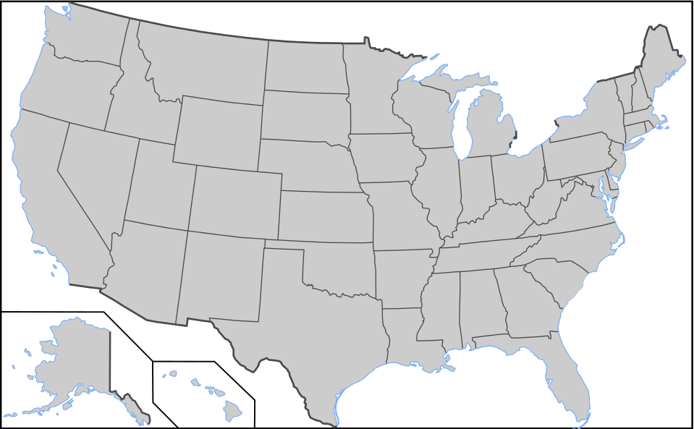
Where are we located
U.S. Bank Farm Management Office Locations
Indicates Farm / Land management offices
1

Slide 5
Northwest Region
Washington/Northern Idaho
NW Region
  Bismarck – 595 acres/farm avg
  Billings – 9,305 acres/farm avg
  Twin Falls – 406 acres/farm avg
  Spokane – 1,406 acres/farm avg
Washington/Northern Idaho
  Serviced out of Spokane
    Washington
    Northern Idaho
    Eastern MT
    Northern OR

Slide 6
Comprehensive Services Provided: Farm Management
Farm leasing and communication
Tenant screening
Lease analysis and negotiations
Farm bill payment and recordkeeping
Frequent client communication and farm reporting (financial and crop reports)
Farm stewardship
Manage farm plans, including fertilizer, seed, herbicide and soils testing
Farm inspections
Manage USDA farm programs
Capital Improvements | cost benefit and cash flow analysis
Disposition and acquisition
Manage all aspects of farm sales, purchases and exchanges
Execute auction format for marketing of farmland
Negotiate and manage easements, wind and solar energy leases
4

Slide 7
Current Management Considerations
Farm Program Elections
  ARC/PLC – annual program payments based on crop and farm history
  Landowner representation for program sign up
CRP Sign-up/Establishment
  Election into the program – short term and long term requirements
  Contract Payment Split Decisions
Rental Options
  Cash Rent/Crop Share arrangements
Grain Marketing
  Income and tax reporting considerations

Slide 8
Farm Asset Transitions
Working Operation
  Land included as part of a farming operation – Owner and Operator
Income Producing Asset
  Land providing income through rental
    Retirement income – current ownership
    Supplemental income – next generation
Legacy Asset
  Continue family legacy of ownership and benefit
    Decisions on ownership structure and management roles
  Philanthropic goals/desires for long term income benefits
    Overall place in larger planning goals

Slide 9
Real Life Situations - Examples
Decisions to the next generation
  Planning versus forgetting
Long term management
  Neighbors/Friends in rental discussions (producer versus owner)
Retirement financial needs
  Nursing home/long term care considerations
Family off the farm – family on the farm
  Undivided owners – differing needs and expectations

Slide 10
U.S. Bank
Specialty Asset Management
Farm, Ranch, Mineral and Timber Management
Jon C. Norstog – VP Farm, Ranch and Timber Management
Jon.Norstog@usbank.com – 509-835-6096
Jordan Urness – VP Wealth Management Trust & Investments
Jordan.Urness@usbank.com – 509-835-6101

