Slide 1
Today’s Economy: Stuck in First Gear or Gaining Momentum
Presented by Doug Wright
Chief Financial Officer
Intermountain Community Bank

Slide 2
Legal Statements
This presentation contains opinions and perspectives that do not necessarily reflect those of Intermountain Community Bancorp, Panhandle State Bank, its Board of Directors and/or its management team.
This presentation may also contain forward-looking statements. These statements are based on management’s current expectations and are subject to a number of uncertainties and risks including, but not limited to, the strength of the future economy, the threat of increasing inflation, the movement of key interest rates, and the company’s ability to effectively respond to these changes. To the extent that potential impacts on company results are discussed, actual results may differ materially.

Slide 3
A Quick Run Through National Macroeconomic Trends
Growth Accelerating?

Slide 4
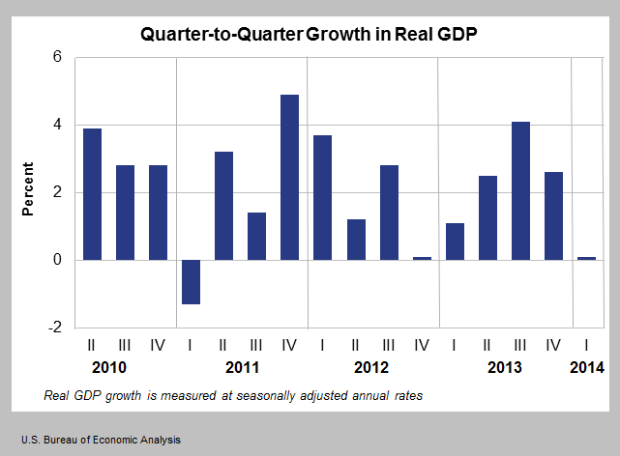
GDP – Weak first quarter, expected to improve through the rest of the year

Slide 5
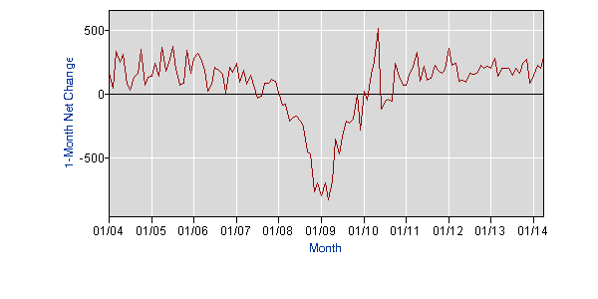
Job gains consistent but still moderate

Slide 6
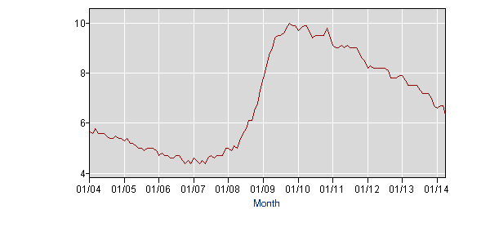
Unemployment Rate – Steady decline, but masks structural issues

Slide 7
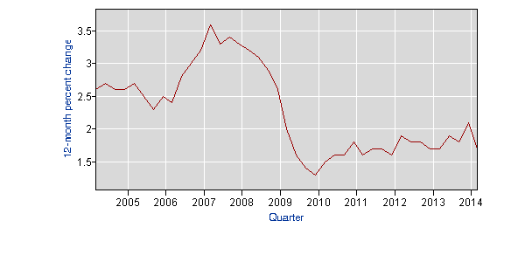
Wage Growth Still Stagnant; median family income stagnant in real terms since 97

Slide 8
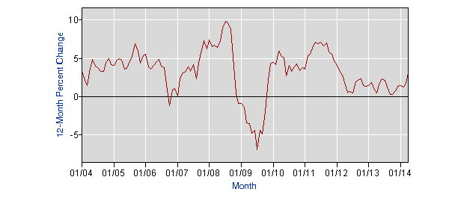
Inflation – PPI generally muted, but uptick in April

Slide 9
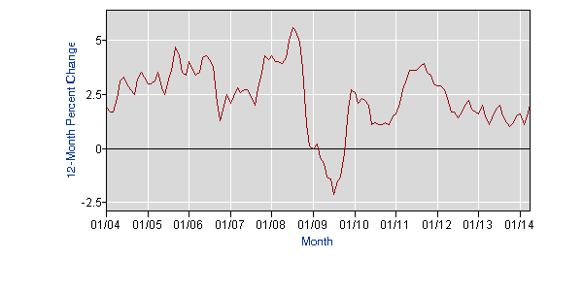
Inflation – CPI moderate as well; generally at low end of Fed target

Slide 10
Global events continue to influence US and local economies
  Europe
    Moderate improvement in 2013, but weak early 2014 results
    Ukraine
    Headlines are gone, but country default risks remain
    Long, slow, volatile recovery
  Asia & S America – China, India, S America growing, but weaker; Japan undertaking massive stimulus
  3rd World – continued economic weakness creates political volatility

Slide 11
Spending & production data reflects moderate expansion
Retail Sales – Reasonably strong, with more consumer confidence
Business Spending – Inventory, technology & equipment spending reflects some expansion, but still caution
  ISM Manufacturing expansionary at 54.9
  ISM non-manufacturing slightly stronger at 55.2
Energy a positive for US – reducing imports and helping to bolster US manufacturing, esp. chemicals
Consumer borrowing increasing, including autos and student loans
Businesses remain cautious but are refinancing; business loan demand starting to increase in certain sectors

Slide 12
Housing is a mixed story
Housing – Supply-demand imbalance driving market
  Inventories are at relatively low levels
  Moderate demand with limited supply leading to substantial price increases – Case-Shiller 12.9% year-over-year as of Feb
  Rising prices and uptick in mortgage rates slowing demand
  Investor money leaving market
  Results:
    Reversal of earlier trend – upper middle/high end selling well; low end soft
    Cautious new housing construction
    Multi-family remains hot

Slide 13
Other macro data:
Other Real Estate:
  Commercial Real Estate – Stabilizing, but long-term worries
  Ag real estate – Strong now, but will ebb and flow with ag cycles
Banking sector:
  Still excess liquidity, but lessening
  Credit – too much chasing too little -- banks pricing competitively, but continued lack of demand
Equity markets – after strong 5-year run, stagnant in 2014

Slide 14
Government activity continues to be a major economic factor
Fed Government Activities
  Deficit coming down, but still big structural issue
  Political gridlock hurts confidence – temporary agreements and reduced deficits relieving pressure, but will build after election
  Tax policy still highly uncertain
  ACA impacts uncertain
  Rate policy remains accommodative – market volatility partially caused by uncertainty on future of FRB easing efforts
State & Local Govt Slowly Improving
  2nd highest contributor to GDP behind consumer
  Short-term budget concerns lessening
  Pension and health care funding will be ongoing problem

Slide 15
The Bond Market & Interest Rates
Why Aren’t Rates Rising Faster?

Slide 16
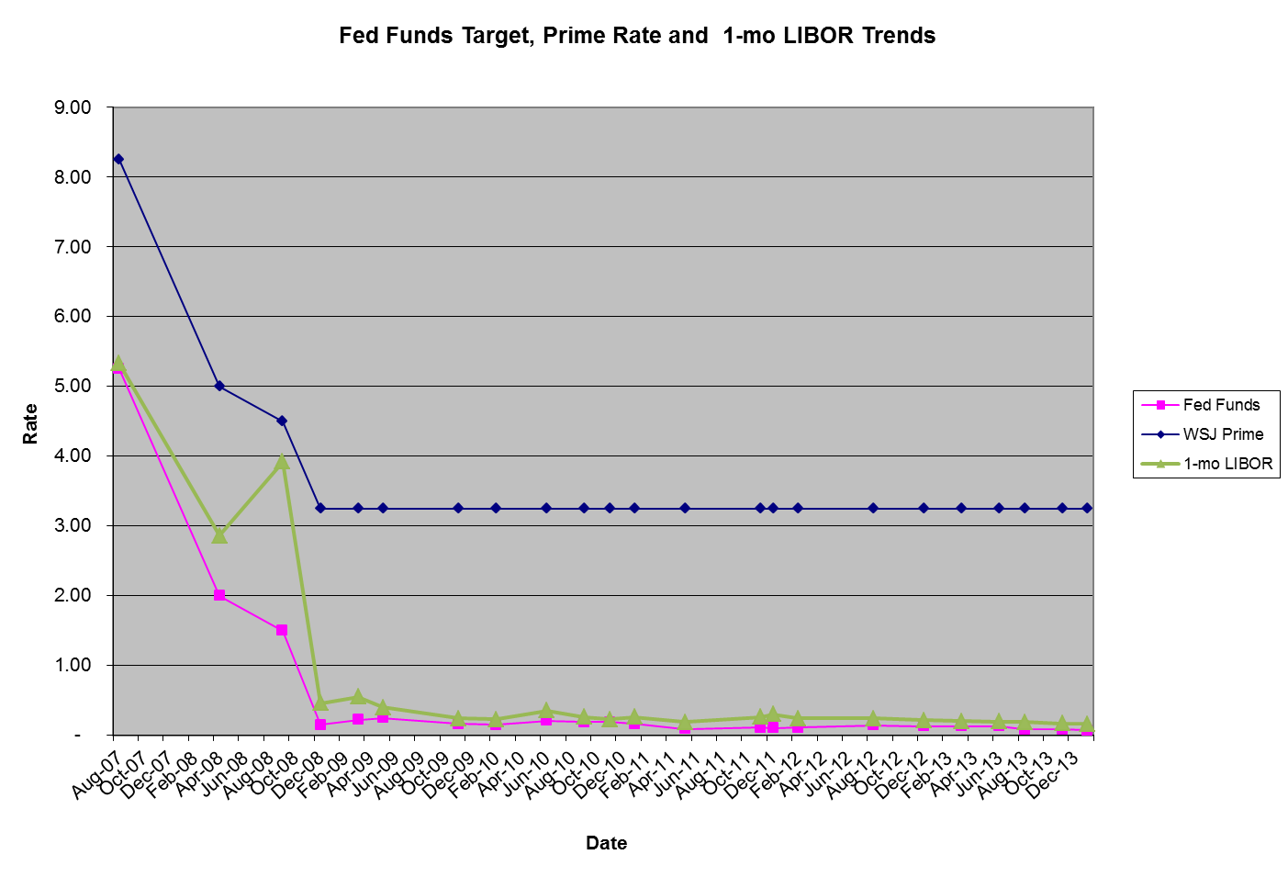
Short-term Rates – Continued record low rates; until next year?

Slide 17
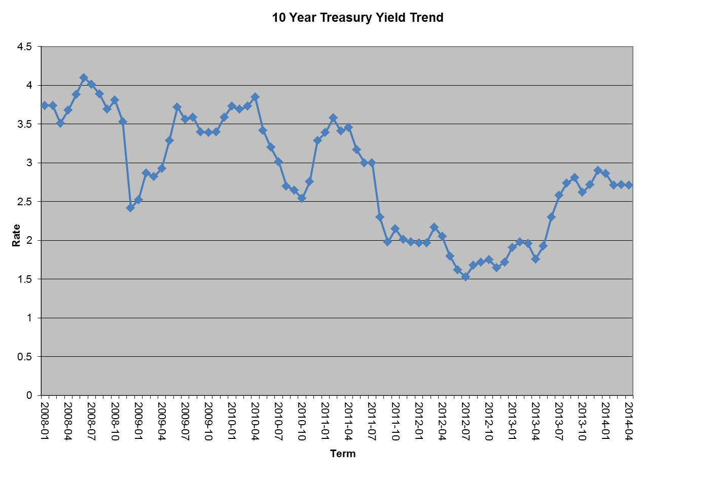
10-Year Treasury: 2013 increase, then stabilization, but for how long?

Slide 18
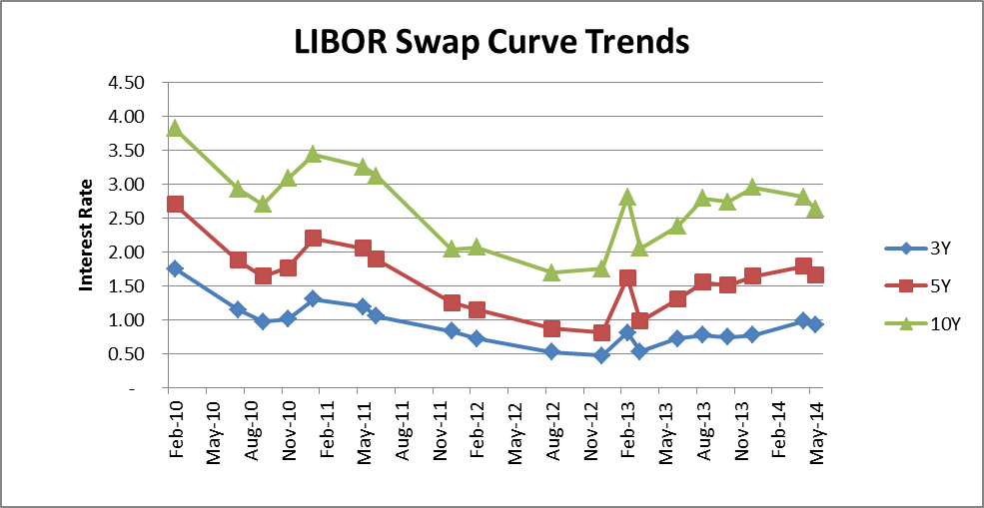
LIBOR-Swap Curve – Bank CD and lending rates continue at historically low rates

Slide 19
Factors Affecting Rates – Supply/Demand
Geopolitical: Ukraine, China
Equity market volatility or stagnation
Foreign government holdings
US government purchases
Issuance down:
  Lower deficit
  New mortgage volume down significantly
  Municipal issuance down significantly
  Corporate cash at high levels
Boomer re-allocations

Slide 20
Factors Affecting Rates – Govt Policy
Fed Bond Purchases
Fed Rate Policy
Fiscal Policy – Tax and Spending

Slide 21
Rate Predictions
Fed Funds Rate/Prime – at current levels through middle of 2015
Overnight/1-mo LIBOR – current level thru early 2015, then beginning to creep up
Intermediate/Long Treasuries – 2.50% is a new floor; creep up in late 2014-early 2015, but not substantially
Mortgage – following Treasuries closely
LIBOR-Swap – moderately up late 2014 and through 2015
Muni bonds: supply/demand imbalance will dampen rate movement

Slide 22
Economic Outlook for Inland NW
Positives
  Spokane/Kootenai County Unemployment Rates Improving
    Kootenai County at 5.4% in April
    Spokane County at 7.9% in March
    Underemployment is still an issue for both counties, as well as nationally.
  Tech and business spending picking up across the region
  Residential RE stock down significantly and prices improving. Continued tight inventory forecast for remainder of 2014 until construction activity catches up.
  Strong pickup in business relocation activity and calls
  Improved diversification, including agriculture, health care, light manufacturing, education, services, tourism and retail will benefit the region in the long-term
  Business friendly region with strong quality of life and relatively low costs
Negatives:
  Concerns rising for ag-based/reliant economies
    Potentially softening prices
    Continued input cost increases
    Farm Bill ends some support payments
  Federal, state and local govt spending improving, but still constrained
  National and international conditions still volatile
  Relatively low wage regional economy
Outlook :
  Region reasonably positioned, but conditions still fragile

Slide 23
Implications/Strategies for Estate Planning

Slide 24
Implications
Sluggish recovery will continue to create investment and planning challenges
  Rates may not move significantly for some time
  Equity markets may be ready for a breather
  Commercial real estate will see profound changes from buying/working trends
    Online activity
    Telecommuting
Demographic/Psychographic changes will challenge status quo
  Boomer retirement
  Technology – dramatic generational differences
  Referrent/trusted advisor roles & marketing changing
Government activities will have impacts
  ACA/Medicare changes
  Government deficit & potential fixes
  Pension underfunding
  Unwinding the Fed balance sheet
  Same-sex marriage and other social changes
Dramatic changes in business life cycles

Slide 25
Implications cont.
Income Inequality
  Social unrest
  Government responses
  Younger generation support of older generations

Slide 26
Strategies
Diversify assets
  Look beyond traditional equity/fixed income segments
  Continue to look globally
  Ladder fixed income
Help plan for long retirements
  Higher savings rates
  Long-term care insurance
  Graduated living
  Explore means to extend resources
    Co-op living
    Multi-generational households
    Social security maximization
  Evaluate solvency of pension providers
  Address health care needs

Slide 27
Strategies, cont.
Understand and adapt to generational differences
  Utilize different tools, learning opportunities and communication styles
  Understand and adapt to risk tolerance differences
  Carefully consider business buy-sell/generational movement plans
    Realistic & reasonable
    Future support & counsel
    Potential future exit strategies
  Address educational needs
Address changing gender roles and attributes
  Changing role of women in income earning, education, financial roles
  Same sex
  Life-span issues

Slide 28
Questions/Comments
For more information, contact:
Doug Wright
dwright@intermountainbank.com
509-363-2635

